Slide 1
MySql Basic Operation

Slide 2
Mysql Common Problems
1. create database ->
2. create table ->
3. create column ->
4. insert data ->
5. display data ->

Slide 3
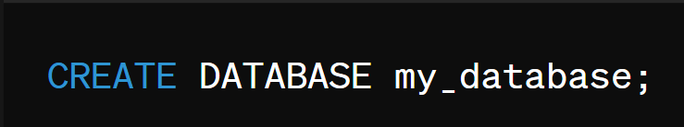
Creating a Database:

Slide 4
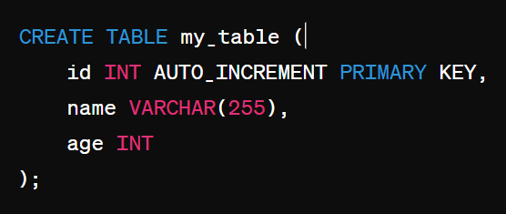
Creating a Table:

Slide 5

Inserting Data:

Slide 6

Selecting(Display) Data:

Slide 7

Updating Data

Slide 8

Deleting Data:

Slide 9


Dropping a Table or Database:

Slide 10
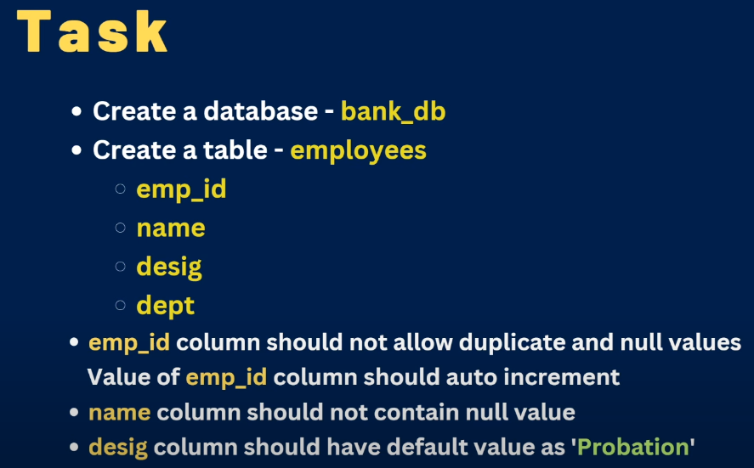
Exercise – 1

Slide 11
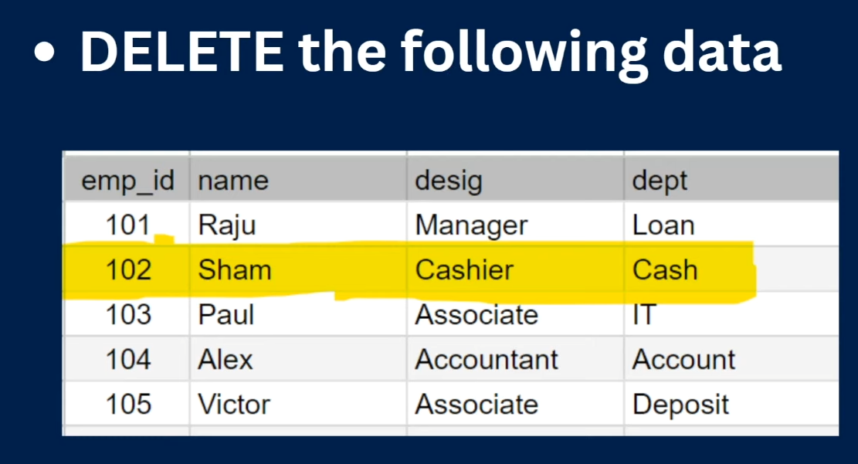
Exercise - 2

Slide 12
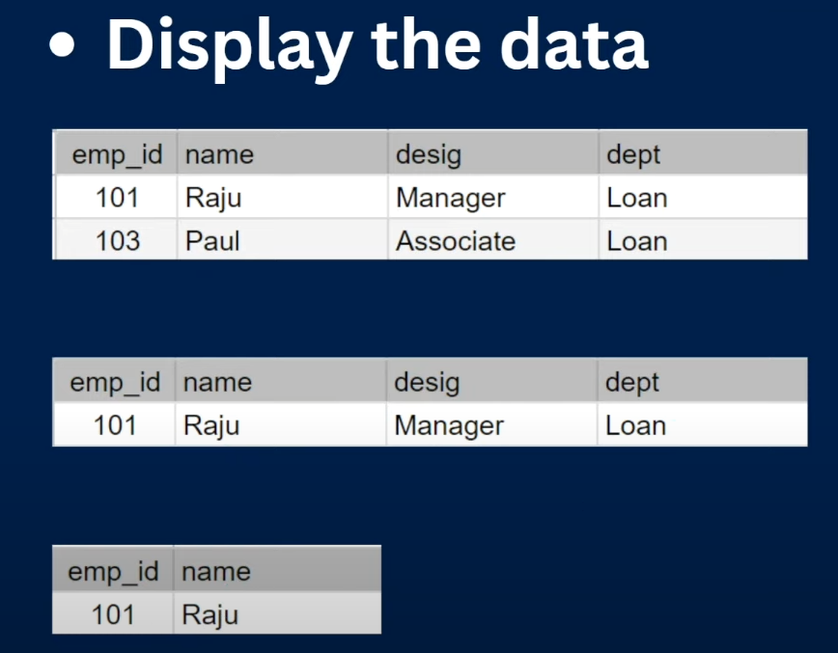
Exercise - 3

Slide 13
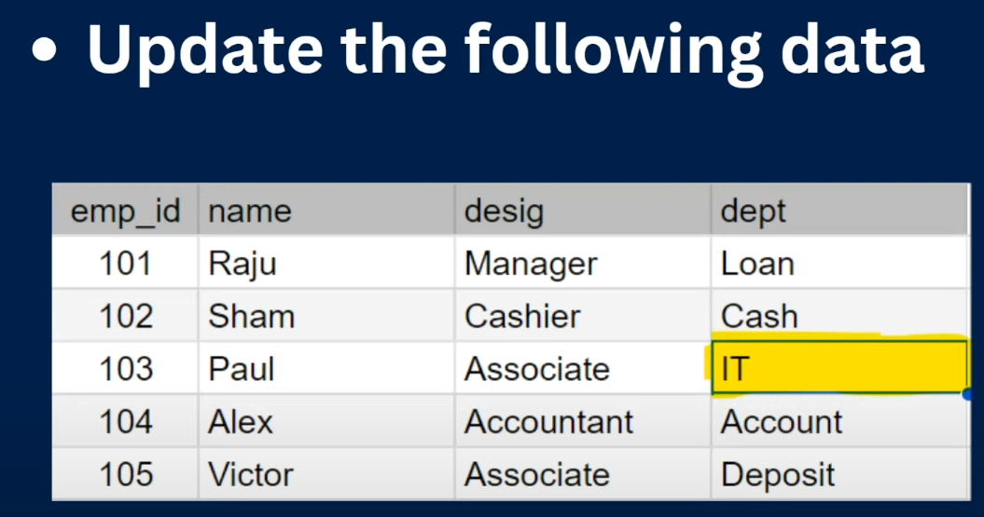
Exercise - 4

Slide 14
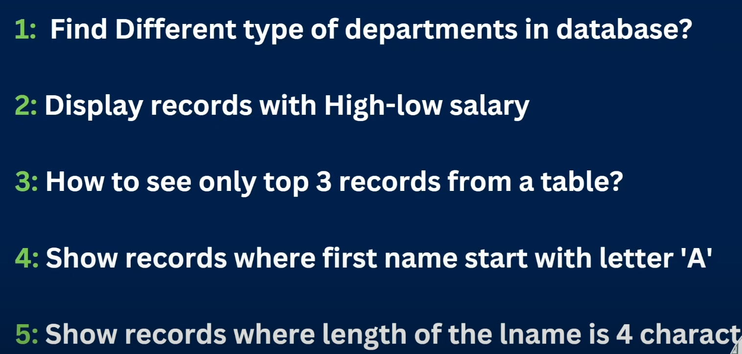
Exercise - 5

Slide 15
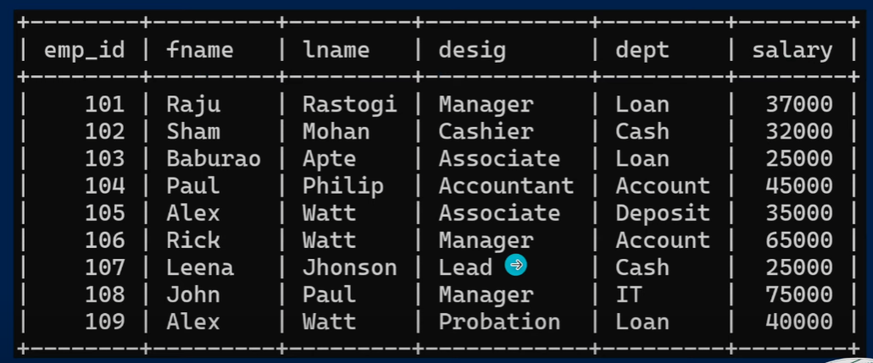
Task 1 : -

